Slide 1
Discipleship
The Biblical Pattern – Week 1

Slide 2


Slide 3
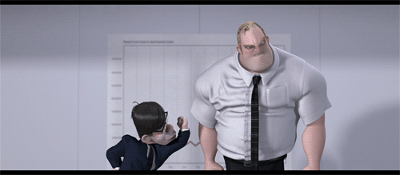
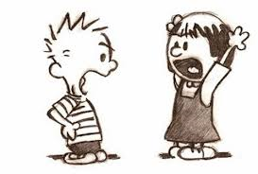
THE HINDRANCES TO THE MINISTRY OF DISCIPLESHIP AND HOW TO GUARD AGAINST THEM AND OVERCOME THEM.
Divisions between the
discipler and disciple.
Intellectual studies
and debates.
Charismatic distractions.
Legalism.
Ceremony.

Slide 4
The results of following this biblical pattern of discipleship.
The example of the Lord Jesus Christ.
  From 12 disciples to Acts 17:6 in one generation!
  Evangelism plus discipleship = multiplication.

Slide 5
Genesis 1:28 And God blessed them, and God said unto them, Be fruitful, and multiply, and replenish the earth, and subdue it: and have dominion over the fish of the sea, and over the fowl of the air, and over every living thing that moveth upon the earth.

Slide 6
The problem with “multiplication” plan.
2 Tim 2:1-4
We have a Position of Strength
For the Mission

Slide 7
Pro 20:6 Most men will proclaim every one his own goodness: but a faithful man who can find?
Ecc 7: 28 Which yet my soul seeketh, but I find not: one man among a thousand have I found; but a woman among all those have I not found.
Ps 12:1 To the chief Musician upon Sheminith, A Psalm of David. Help, LORD; for the godly man ceaseth; for the faithful fail from among the children of men.

Slide 8
The problem with “multiplication” plan.
2 Tim 2:1-4
We have a Position of Strength
For the Mission
Which is Hard

Slide 9
1 Thes 2:19 For what is our hope, or joy, or crown of rejoicing? Are not even ye in the presence of our Lord Jesus Christ at his coming? 20For ye are our glory and joy.
2 Thes 3:13 But ye, brethren, be not weary in well doing.
Gal 6:9 And let us not be weary in well doing: for in due season we shall reap, if we faint not.

Slide 10
The problem with “multiplication” plan.
2 Tim 2:1-4
We have a Position of Strength
For the Mission
Which is Hard
So We Must Stay Focused for It!

Slide 11
The example of the Apostle Paul.

Slide 12
The Great Commission can be fulfilled by any local church.

